Slide 1

E-Commerce Review Analysis
- APSSDC Internship

Slide 2

Lot of Doubt's
Is there any discount ?
Is there any warranty ?
Can we trust the product work good ?
Is customers satisfied with the product ?
Is the product quality good ?

Slide 3

Solution Proposed
E-Commerce Review Statistics Method using Sentimental Analysis

Slide 4








Why this Topic…
1
Global ECommerce Sales - More than USD 4 Trillion
( 2021 )
4
Feedback Analysis
2
Customer Satisfaction
5
Huge Data
3
Product Improvisation
6
Need of an efficient method

Slide 5

About the Idea
It is a project which we intend to make using Sentimental Analysis to Segregate the User Reviews on E-Commerce Platforms into three categories.
Positive
Negative

Slide 6


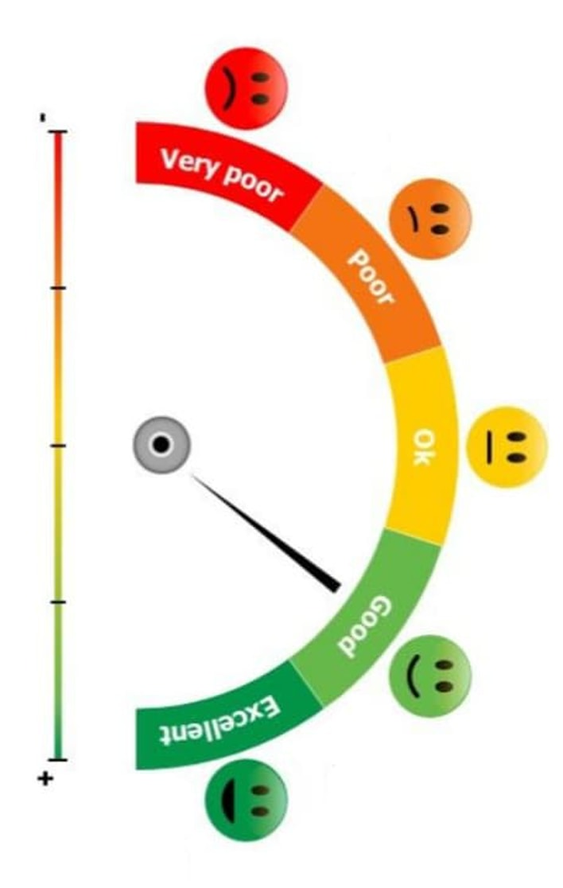





→ Examples:
Positive
I likes the quality of the product.
My order received safely without ant damage and perfect cloth fabric.
I am impressed with the discount offers.
Negative
The product which I ordered is very bad quality.
The order delivered very late I am not satisfied.
The product is very expensive when compared with other websites. I am not satisfied.

Slide 7
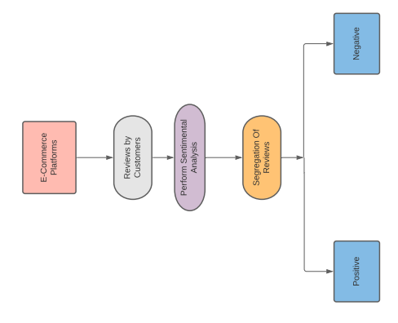
Flow Chart
Understanding the sentiment of the textual data is a very crucial component in data science.

Slide 8
Our Team
APSSDC Internship
Mohammed Khizar Baig
Boyapati Sai Venkat
G.B.N.V.S. Abhinav
Ishita Agrawal
Aravind Bhaskar

Slide 9
Hope You Like It
→By Group - 13
Notes:
https://unsplash.com/photos/B6yDtYs2IgY

Slide 10

THANK YOU

